Slide 1
Bel Air Dam Removal Community Meeting
December 5, 2023

Slide 2
Agenda
Project Background
Alternatives Analysis
Working Drafts of Current Stream Layout/Profile
Existing Conditions
Dam Ongoing Inspection and Maintenance
Emergency Action Plan
Proposed Conditions
Anticipated Impacts
Environmental Justice
Mitigation
Restoration of Downstream Parcel
Permitting
Schedule

Slide 3
Project Background

Slide 4
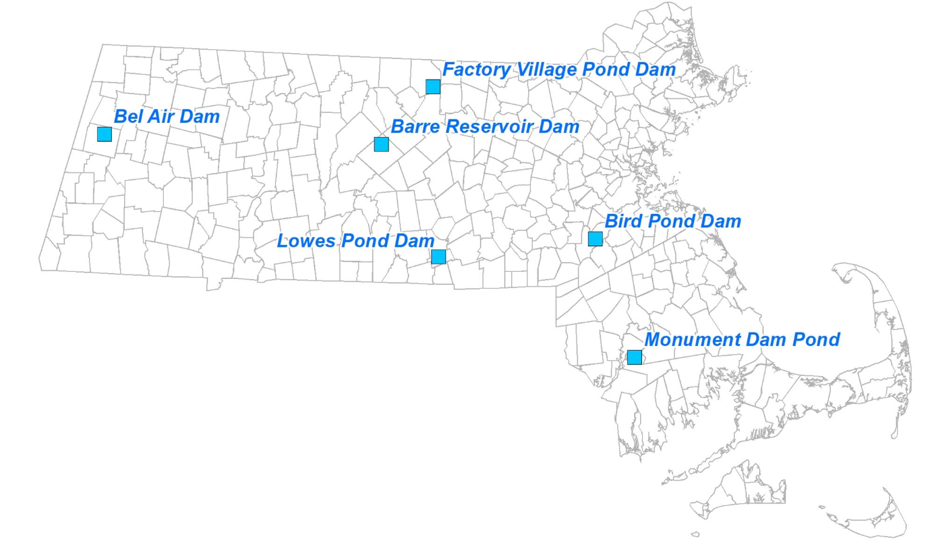
DCR Abandoned Dams Program
These 6 are some of the many abandoned dams with no active ownership in the state. These were prioritized because they are the highest risk to the public as all are Significant or High Hazard dams in Unsafe to Poor condition. Currently Dam Safety inspects each dam regularly and hires contractors to perform maintenance as needed at Commonwealth’s cost. Currently none comply with Dam Safety Regulations.
Lowes Pond Dam, Oxford
Monument Pond Dam, Freetown
Factory Village Pond Dam, Ashburnham
Bird Pond Dam, Walpole
Bel Air Dam, Pittsfield
Barre Reservoir Dam, Barre

Slide 5
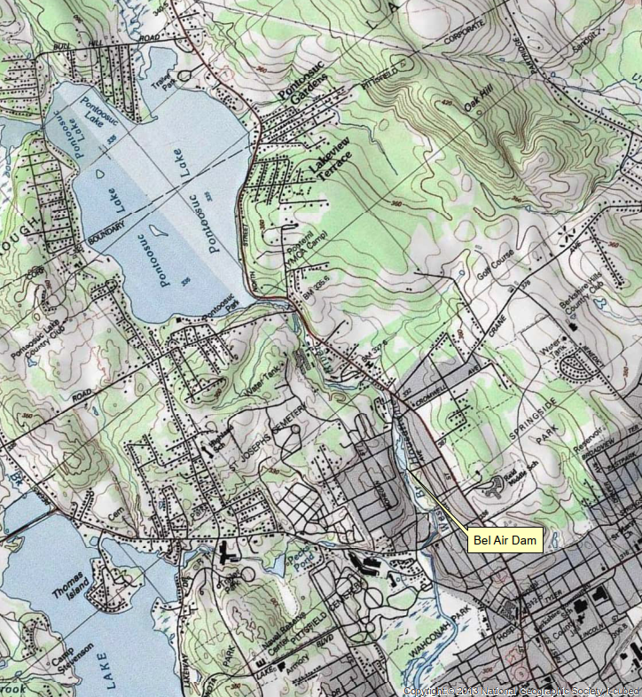

Slide 6
Bel Air Dam Pittsfield

Slide 7
Phase II Investigation and Alternatives Analysis Components – 2019 -2020
Condition Assessment
Topographic / Bathymetric Surveys
Subsurface Investigation
Spillway Adequacy Evaluation
Seepage and Stability Evaluation
Sediment Sampling and Management Plan
Develop Alternative Concepts / Costs (Repair, Partial Removal, Full Removal)

Slide 8
Alternatives Analysis
No Action
Repair
Restoration of dam to meet Massachusetts Dam Safety Regulations
Sediment removal
Ongoing operation and maintenance of a High Hazard Dam
Requires Municipal or other Owner Commitment to Achieve Property Ownership
Partial Removal
Reducing height of dam and storage capacity of spillway
Result in reclassification as non-jurisdictional
Full Dam Removal
Generally Preferred Given No Municipal Interest in Dam Repair

Slide 9
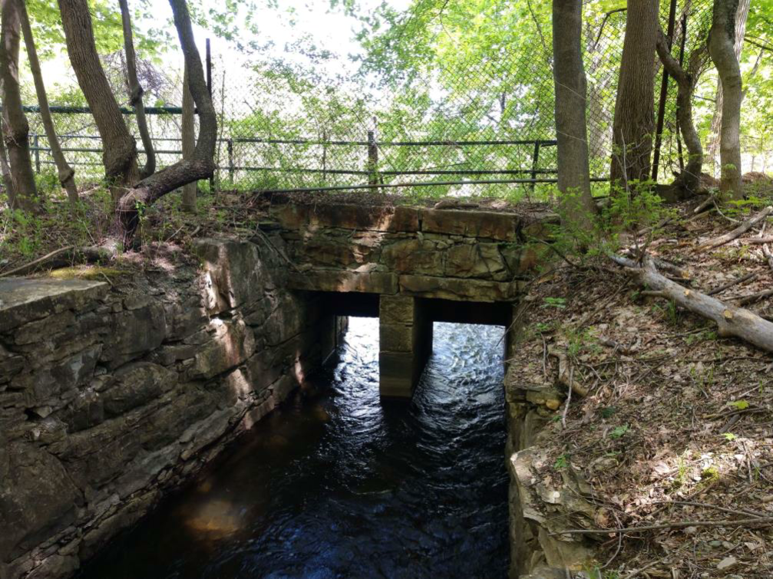
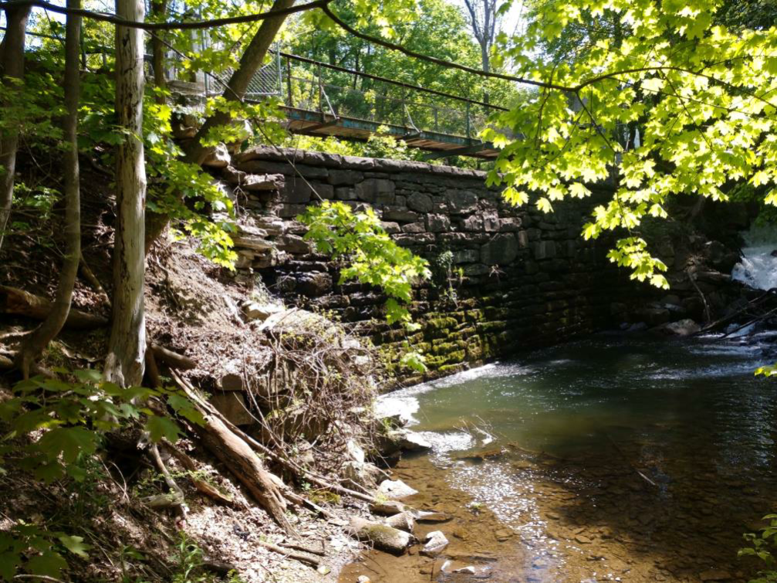
Bel Air Dam, Pittsfield, MA
Built in 1832
Used for power generation for a woolen mill until 1920s
Owner is deceased
Combined earthen embankment, stone masonry, and concrete structure
Height of 26.5’, 200’ long with a capacity of 56 acre-feet
Upstream of several businesses, residences and roads
Failure may cause loss of life and substantial damages
High hazard dam classification
Unsafe condition and Structurally Deficient
City in support of dam removal – preferred alternative
Current dam removal cost estimate: Approximately $19MM
View of sluiceway from
downstream side of dam.
View of auxiliary spillway from
downstream side of dam.

Slide 10
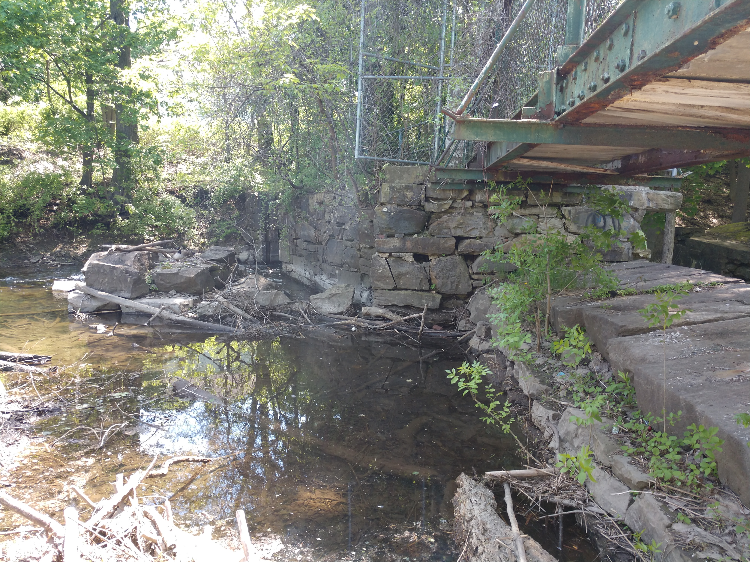
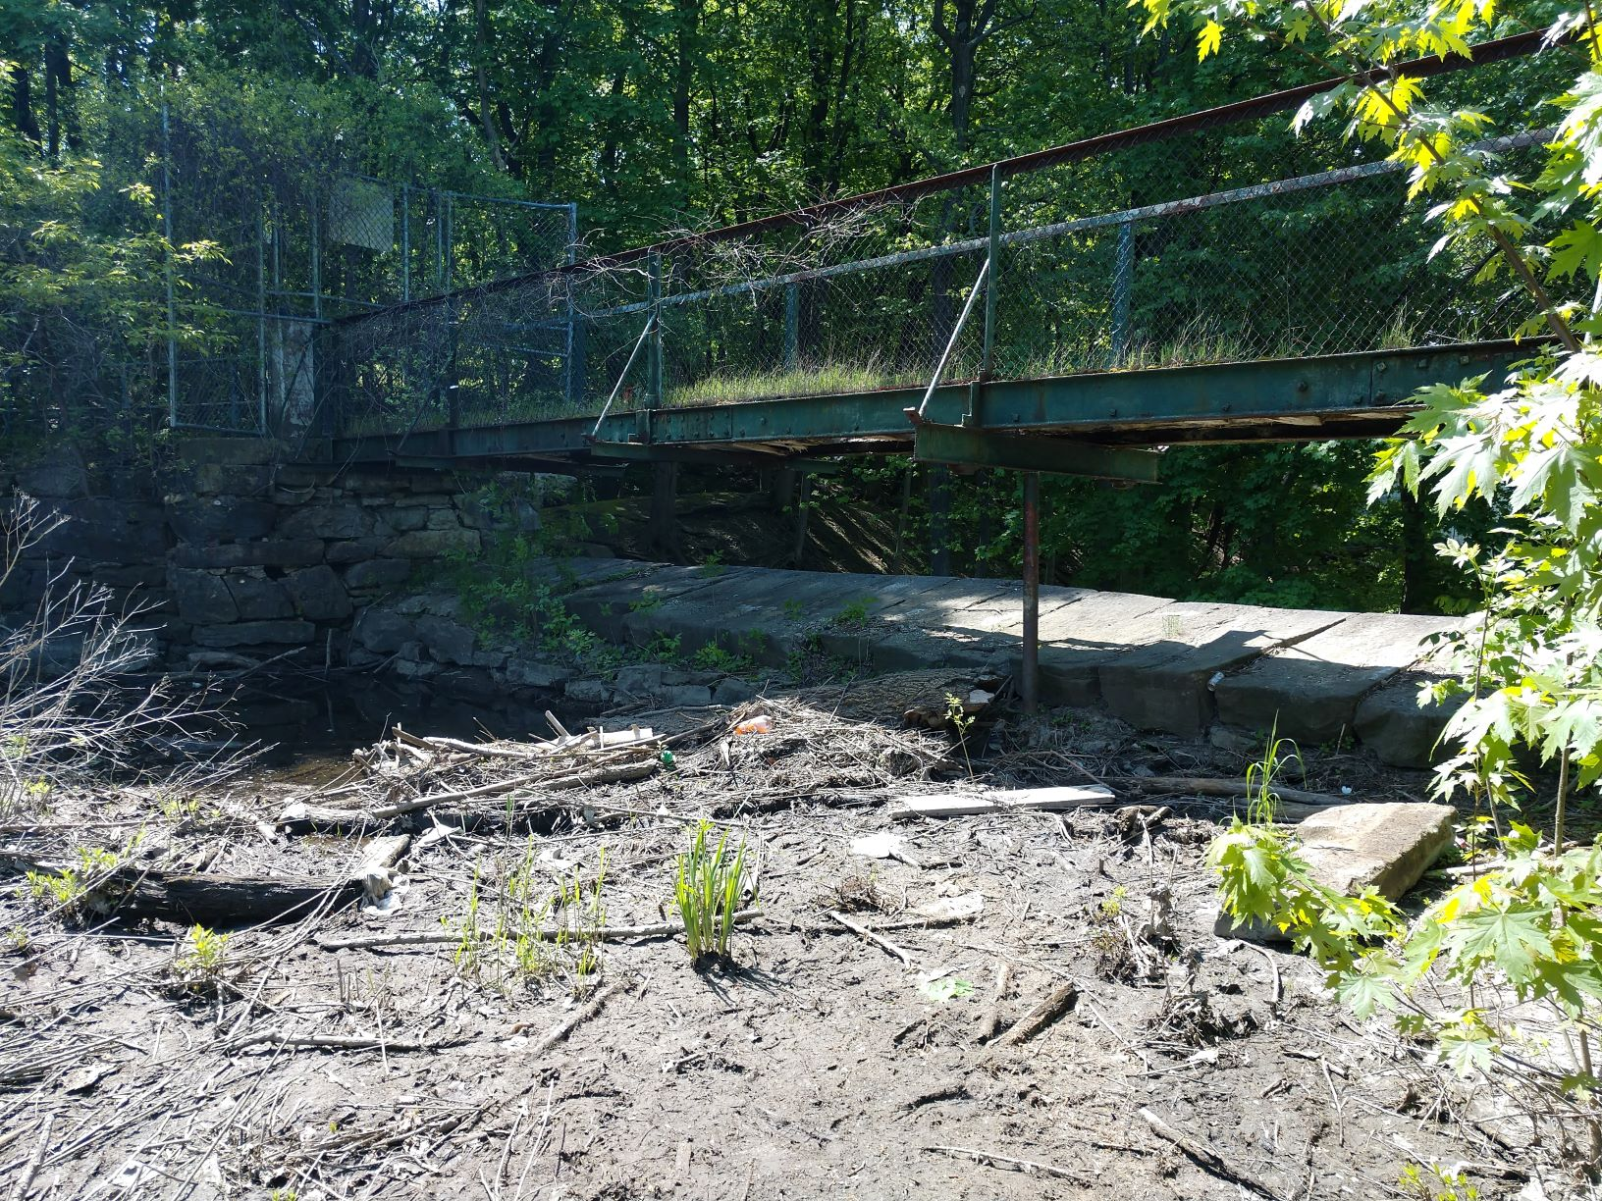
Existing Conditions

Slide 11
Ongoing Inspection and Maintenance
DCR Office of Dam Safety (ODS) periodically inspects dam and includes Bel Air Dam in their patrols
Inspected in May 2023 and again following storm event on July 19, 2023
Next inspection scheduled for December 2023
DCR ODS has conducted minor repairs and maintenance as needed
Added riprap slope protection to a section of the center embankment’s downstream slope to stabilize sluiceway discharge
Debris is removed as needed from sluice gate openings to maintain minimum water level

Slide 12
Emergency Action Plan
2017 Emergency Action Plan (EAP)
Emergency Preparedness Document serves as a guide to local and state emergency responders in event of a possible failure
EAP on file with the City Emergency Management Agency, Massachusetts Emergency Management Agency, and DCR Office of Dam Safety
EAP identifies notifications to inform first responders and other applicable agencies
EAP includes description of potential inundation area that may be impacted in the event of failure, which can be used for evacuation planning purposes

Slide 13
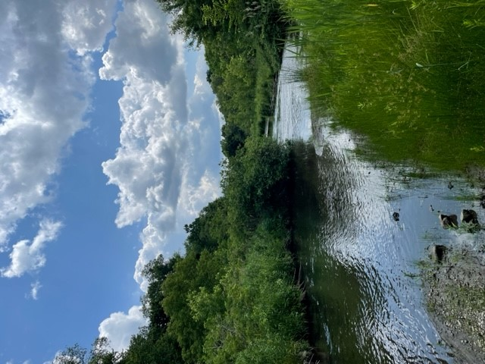
Existing Conditions

Slide 14
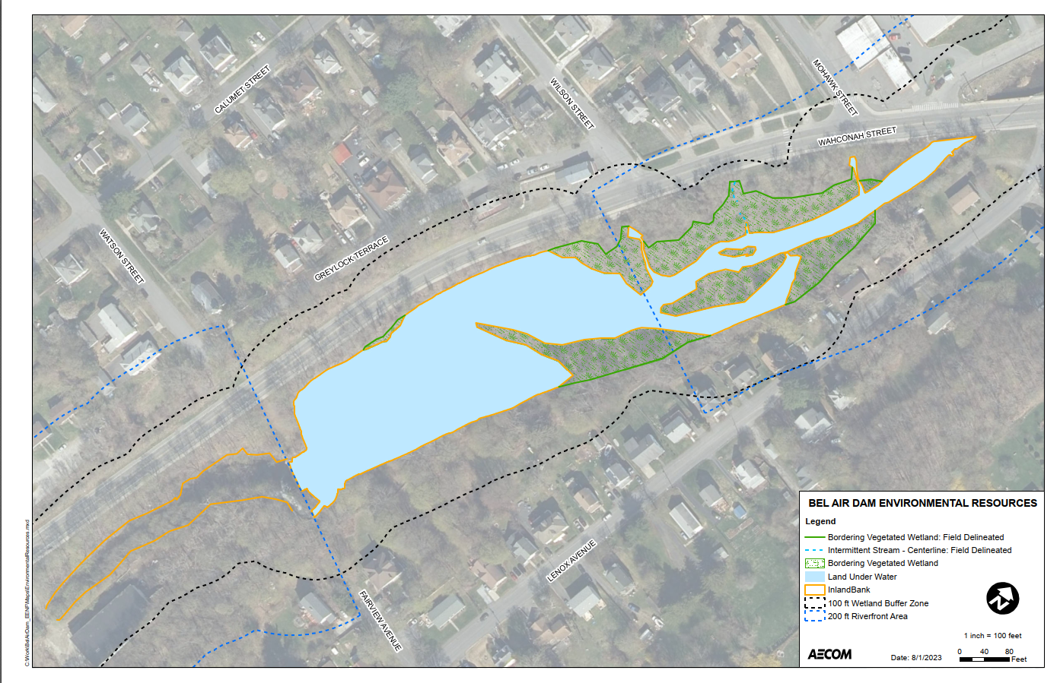

Slide 16
Existing Sediment
Sediment currently below water, but will be above water after dam removal and subject to MCP reporting requirements after dam removal
Exceedances
Chromium
Arsenic
Lead
PAHs
EPHs
Disposal required out of state

Slide 17
Proposed Conditions
Removal of dam spillway and appurtenant structures
Restoration of approximately 1200 feet of the existing streambed of the West Branch of the Housatonic River
Bank grading, stabilization, and reconstruction of a low-flow channel
Ecological restoration of wetland/floodplain habitat adjacent to the channel
Dredging of 35,500 CY of contaminated sediment

Slide 18
Current Working Draft of Restored Stream Layout

Slide 19
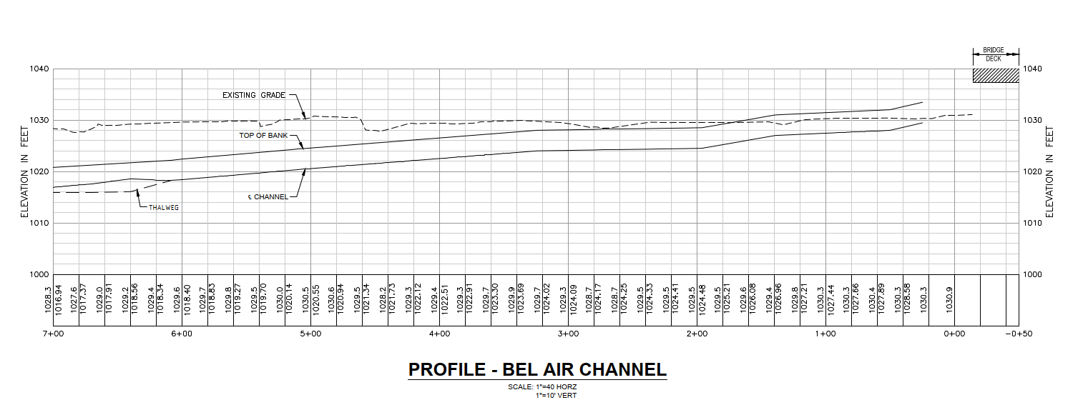
Current Working Draft of Restored Stream Profile

Slide 20
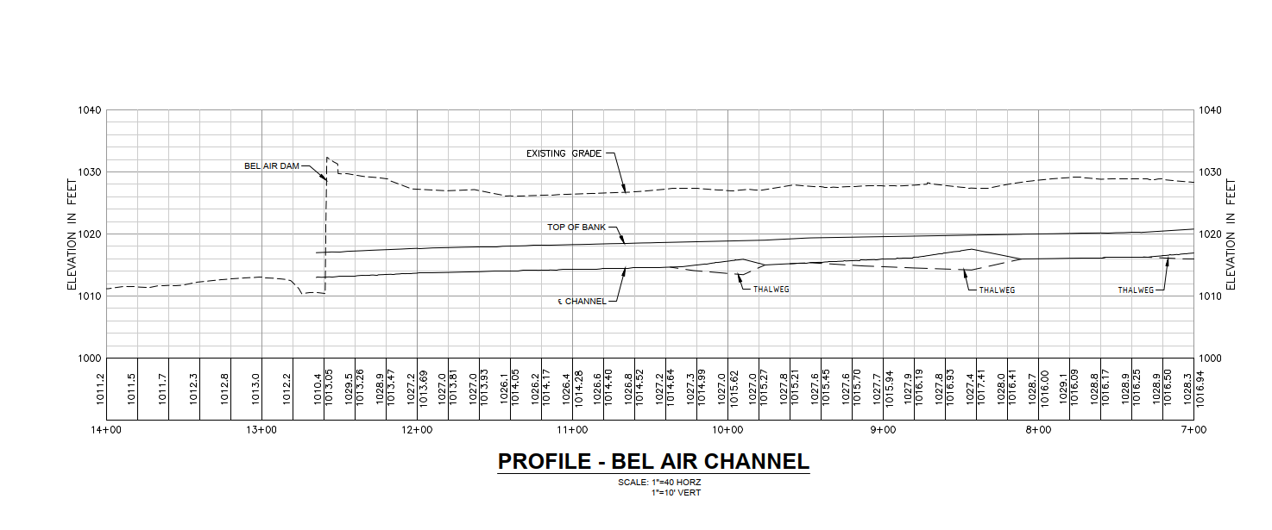
Current Working Draft of Restored Stream Profile

Slide 21
Current Working Draft of Typical Section

Slide 22
Proposed Impacts
Temporary and permanent impacts to wetland resource areas
Currently no known impact to Historic and Archaeological Assets of the Commonwealth – consultation with MHC and THPOs pending
Impoundment adjacent to the dam removed to create new stream channel
Temporary sediment stockpiling
Construction period traffic, sidewalk, noise, and air quality impacts

Slide 23
Wetland Resource Area Impacts
Bank
All existing Bank impacted due to creation of new streambed
Bordering Land Subject to Flooding (BLSF)
Net increase in BLSF due to change in stream alignment/loss of LUW
Bordering Vegetated Wetland (BVW)
BVW loss due to stream reconstruction
BVW habitat restored along new Bank
Land Under Water (LUW)
Permanent LUW loss due dam removal, reducing impoundment
200-foot Riverfront Area
- Increase due to impoundment removal and restoration of natural stream alignment

Slide 24
Environmental Justice Communities

Slide 25
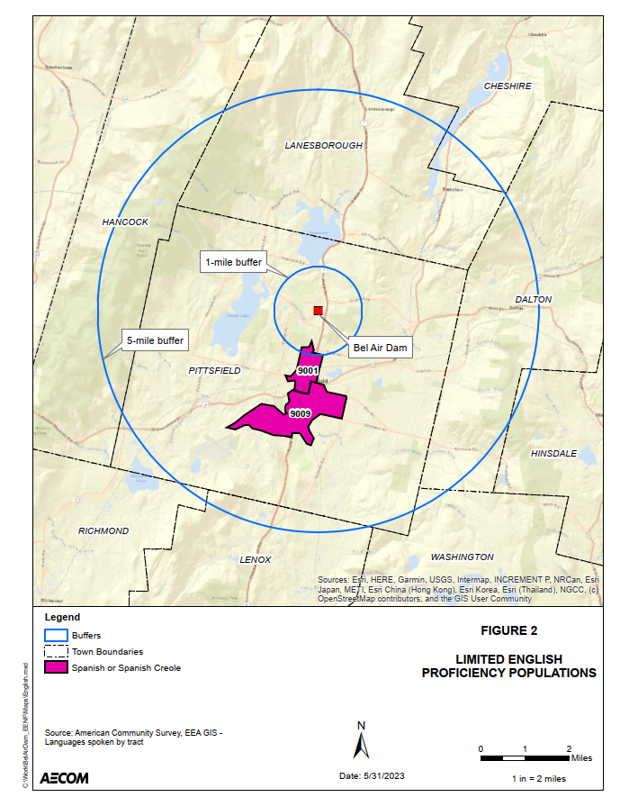
Limited English Proficiency Populations

Slide 26
EJ Impacts
Currently, dam failure would cause significant property damage and potential loss of life
Project will benefit EJ populations due to the removal of an unsafe dam
Project will also remove contaminated sediment, restore natural hydrology, and contribute to restoration of West Branch of the Housatonic River
No expected long-term negative environmental or public health impacts
Short-term construction impacts
Noise
Air quality – emissions and dust
Traffic

Slide 27
Mitigation
Traffic/Pedestrian Management Plan
Daytime/Work week construction hours
Dust mitigation
Air quality monitoring
Silt fences, straw bales, and turbidity controls
Around sediment stockpiles
Around phased in-water work
Habitat restoration/Sediment stabilization
Tree and shrub planting
Seeding
Restoration of wetland habitat

Slide 28
Downstream Parcel – 370 Waconah Street
Currently not owned by City of Pittsfield
Previous owner, Barry Hollister, is deceased
Vacant since 1986
Concrete slabs of former mill buildings remain; buildings removed in 2009
Phase I and II Site Assessments identified arsenic and cadmium above MCP Reporting Levels
Method 1 Risk Assessment determined No Significant Risk to human health, public safety, public welfare and the environment
Anticipated to be used for staging during dam removal
City plans to redevelop for light industrial use

Slide 29
Permitting Requirements
Massachusetts Environmental Policy Act
Pittsfield Conservation Commission/Mass DEP WPA NOI
MassDEP 401 Water Quality Certification
US Army Corps of Engineers Section Clean Water Act Section 404 Pre-Construction Notification (PCN)
MassDEP Chapter 91 License
FEMA Conditional Letter of Map Revision
Massachusetts Historical Commission Project Notification Filing
USFWS Endangered Species Consultation

Slide 30
Tentative Schedule*
MEPA Submittal: January 2024 (initiates official public comment period)
Additional Geotechnical Analysis: January 2024
USACE PCN Submittal: March 2024
FEMA CLOMR Submittal: Spring 2024
Final EIR and State/Local Permit Application Submittals: Spring 2024
Final Design: Spring - Fall 2024
Bidding: Winter/Spring 2025
Construction: Summer 2025
*Schedule dependent on weather and regulatory agency review timeframes and may be extended such that construction would begin in spring 2026

Slide 31
Bel Air Dam Removal
September 5, 2023

Slide 32
